Slide 1
Community Land Trusts
Rosemary Seagrief Gloucestershire Land for People
CLT/Gypsy Site Self-Build Seminar, 13 January 2011

Slide 2
“The biggest challenge for the ‘Big Society’ is whether it is big enough for everyone. ”
From Cutting It, The ‘Big Society’ and the new austerity, New Economics Foundation, 4 Nov. 2010

Slide 3
Gloucestershire Land for People
A regional umbrella body that develops and supports Community Land Trusts (CLTs) throughout Gloucestershire

Slide 4
What does GLP do?
GLP supports the development of robust and sustainable communities by enabling people in towns, villages and the countryside to set up CLTs that own, develop and run assets, such as affordable housing, workspace, recreational facilities and land for growing food, for the benefit of the community in which they live and work.

Slide 5
What kind of organisation is a CLT?
All CLTs share these characteristics:
Not-for-profit status
Incorporated
Operate within a tightly defined community
Democratic control by members of that community
Provide an asset lock

Slide 6
Key aims of CLTs
Affordability in perpetuity
Stewardship
Sustainability

Slide 7
Legal status of CLTs
Legally defined in the Housing and Regeneration Act 2008, Section
Usually constituted as Industrial & Provident Societies or Companies Limited by Guarantee, some with charitable status, all not for profit

Slide 8
CLTs in action in England
c 70 CLTs around the country (numbered dots)
5 existing support bodies (red)
1 potential support body (orange)

Slide 9
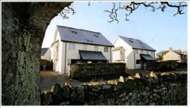
Rural
Blisland, Cornwall
Holy Island of Lindisfarne

Slide 10
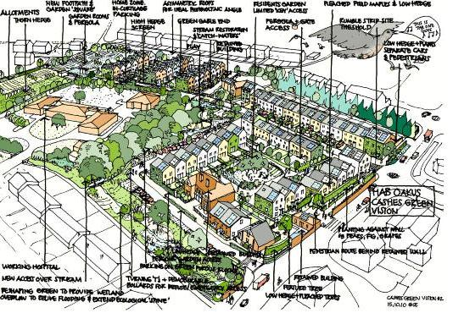
Urban/large scale – Cashes Green

Slide 11
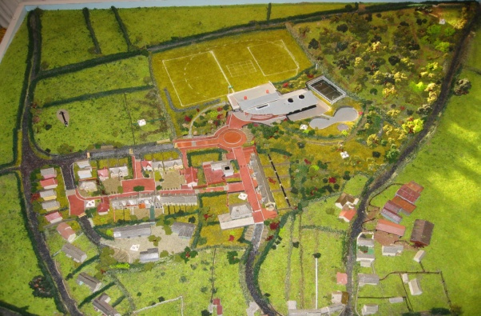
More than housing – High Bickington

Slide 12
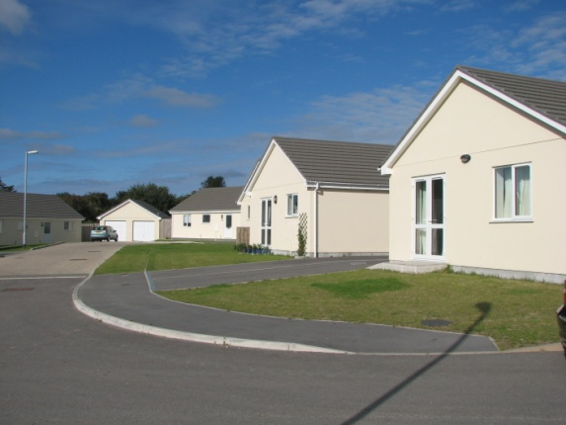
Self build – St Minver, Cornwall
12 homes
Land - £10,000 per plot, inc. planning
Total cost £77,000 (2-bed), £85,000 (3-bed)
Av. omv c£320,000
Interest free loan from North Cornwall DC
Resale covenant

Slide 13
Challenges
Securing land at low or nil cost
Raising development funding
Getting mortgages (at all, or on capped resale prices) and conditions placed on them
Capacity of community groups
Bureaucracy

Slide 14
Key factors for success
One-to-one advice and technical support
Support of local agencies
Partnership working
Access to start-up funding
Wide community engagement

Slide 15
What help is out there?
Some key organisations supporting CLTs
National CLT Network – www.communitylandtrust.org.uk
CLT Fund – www.cltfund.org.uk
DTA and its Asset Transfer Unit – www.dta.org.uk
...to name but a few

Slide 16
Thank you
Rosemary Seagrief
Development Manager
Gloucestershire Land for People
The Exchange, Brick Row, Stroud, GL6 6XZ
e-mail: rose@gloucestershirelandforpeople.coop
tel: 08453 457 599
mob: 07726 360 560
www.gloucestershirelandforpeople.coop

